Slide 1
Search Result Interface
Hongning Wang
CS@UVa

Slide 2
Abstraction of search engine architecture
Indexed corpus
Crawler
Ranking procedure
Feedback
Evaluation
Doc Analyzer
(Query)
Query Rep
User
Doc Representation
Ranker
Indexer
results
Index

Slide 3
Search interface
Evolution of Google’s result interface
http://www.seosmarty.com/google-interface-evolution/

Slide 4
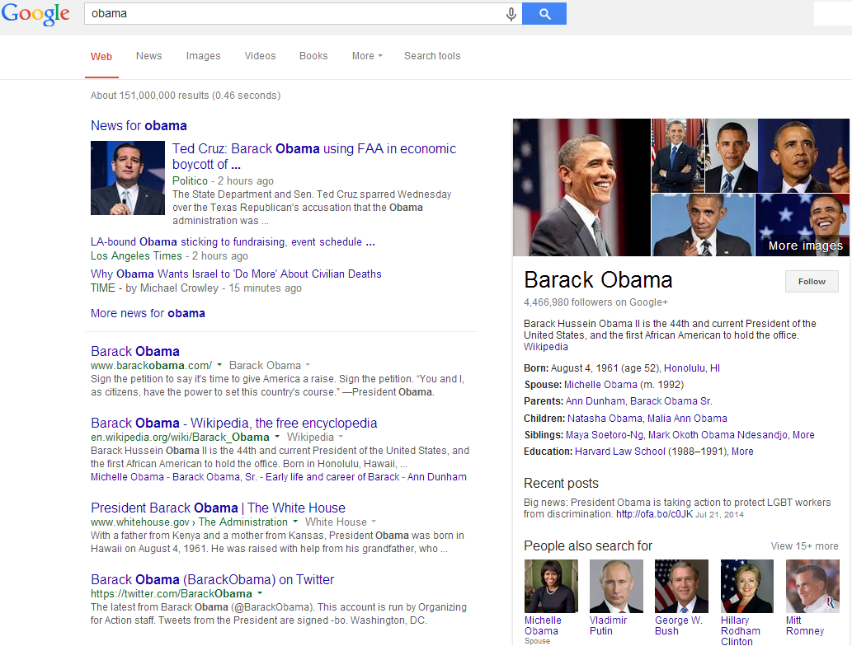
Google’s

Slide 5
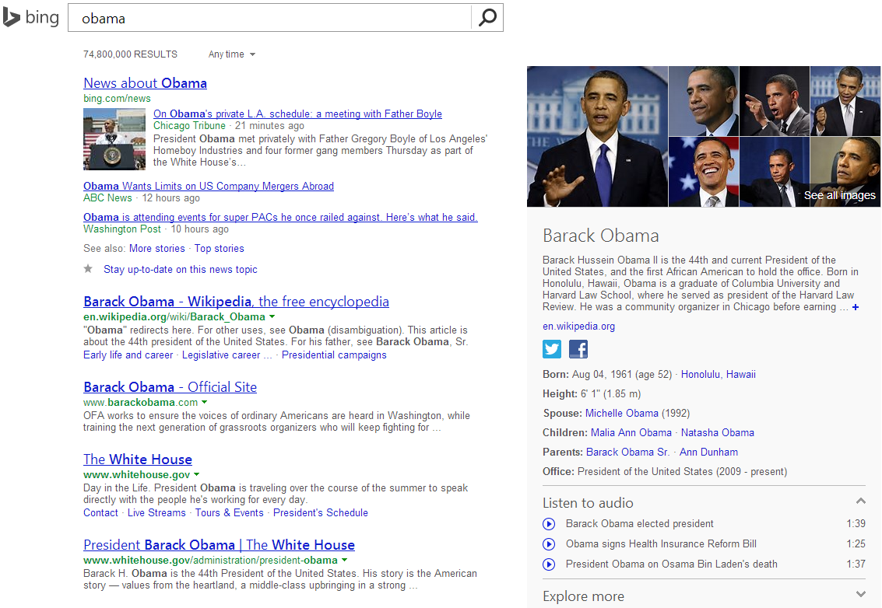
Bing’s

Slide 6
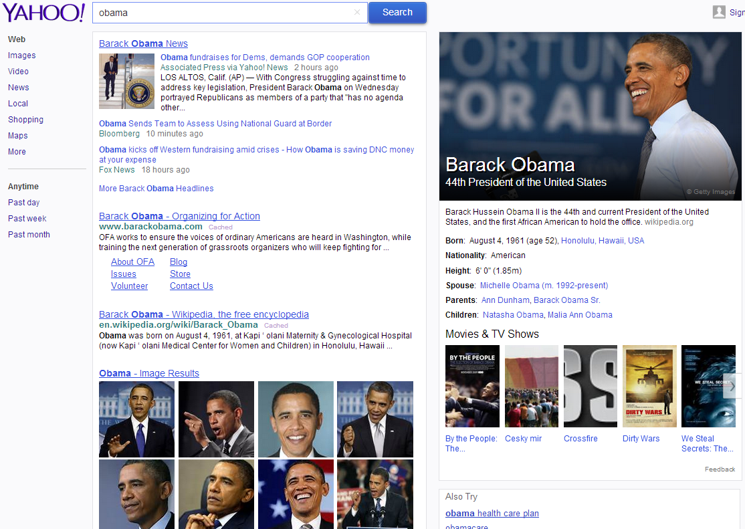
Yahoo’s

Slide 7
What are there
It has been there since the search engine was born
A list of links to the search result page
Text summarization of the retrieved document
Title + text snippet
Search suggestions
Related search
Spelling correction
Query auto-completion
Vertical search
Image, shopping, news
Knowledge graph
As a result of NLP techniques
Simple Q&A

Slide 8
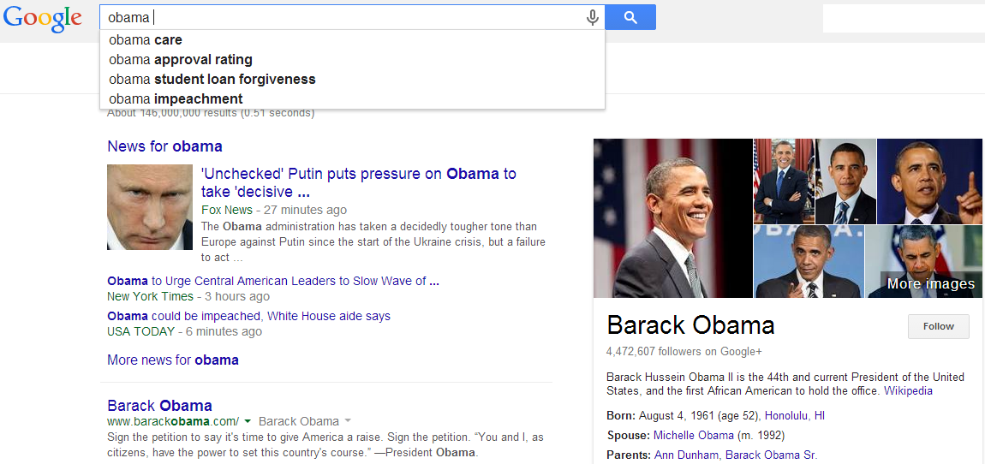
Query auto-completion

Slide 9
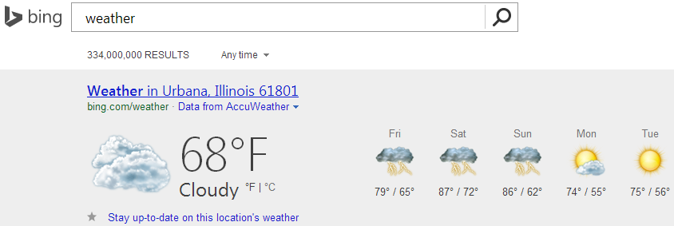
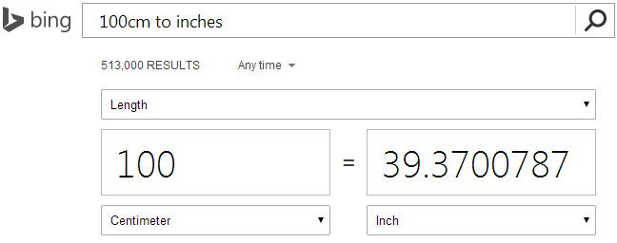
Direct answers
Advanced version of “I’m feeling lucky”

Slide 10
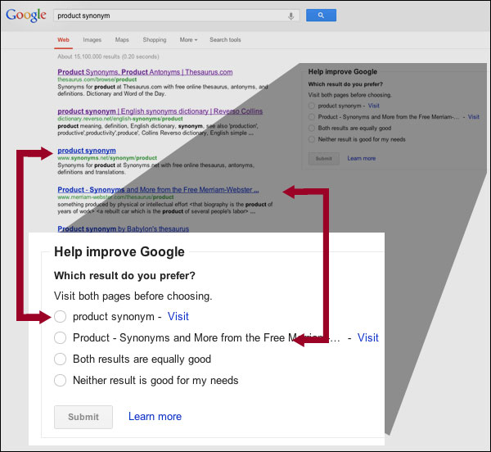
Experimental features
Search result feedback

Slide 11
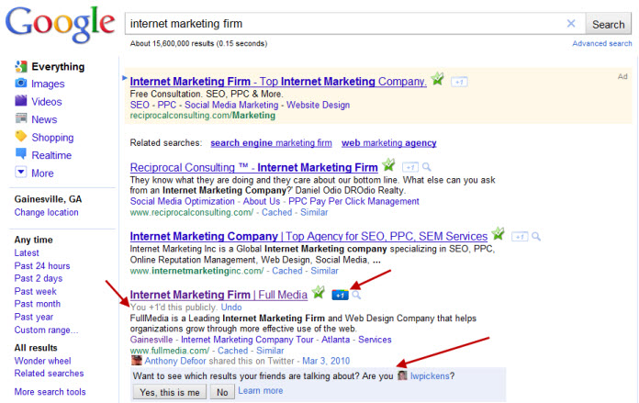
Experimental features
Collaborative ranking

Slide 12
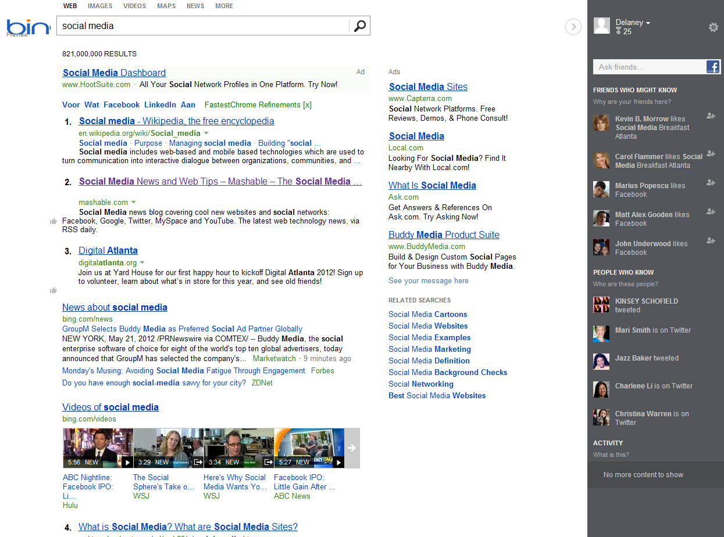
Experimental features
Social panel

Slide 13
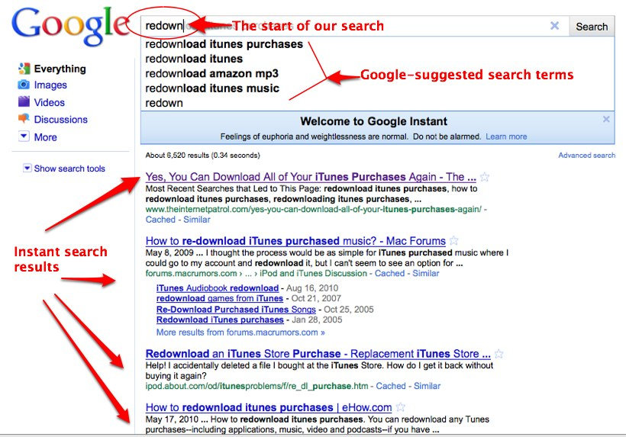
Instant search

Slide 14
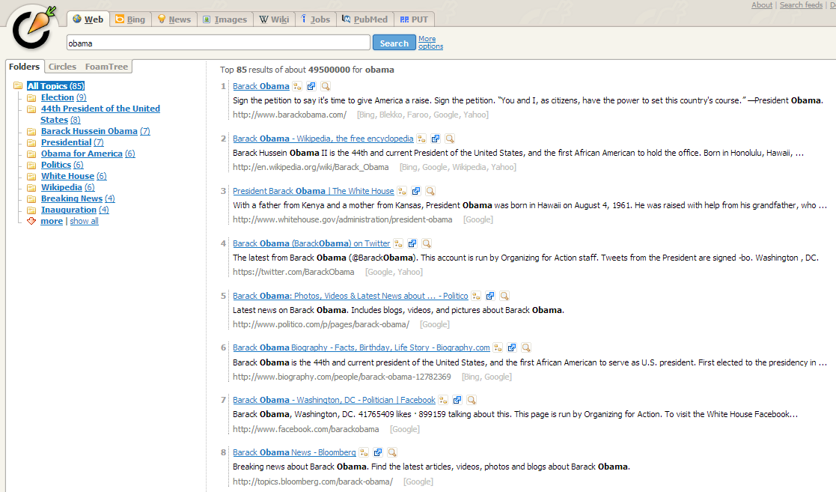
Carrot2’s folder display
Organized results

Slide 15
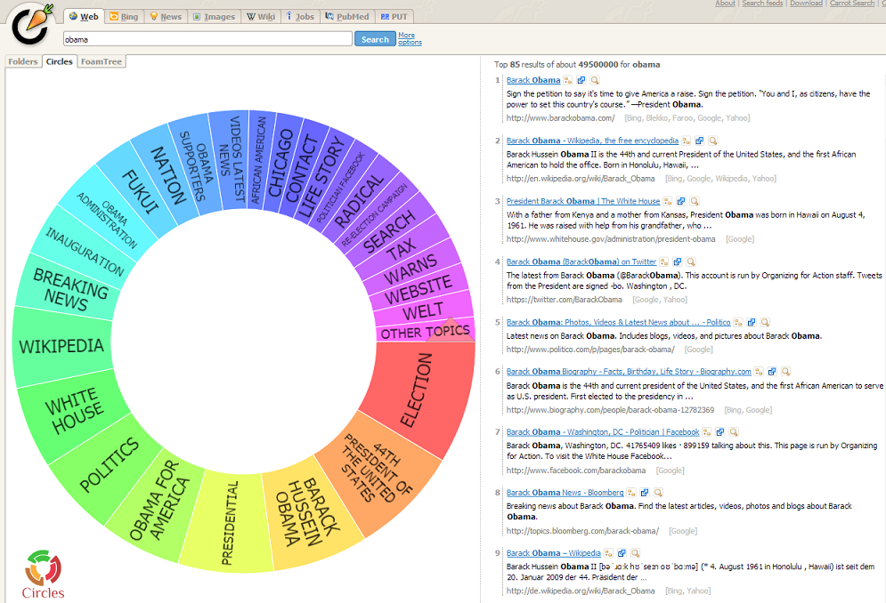
Carrot2’s circle display

Slide 16
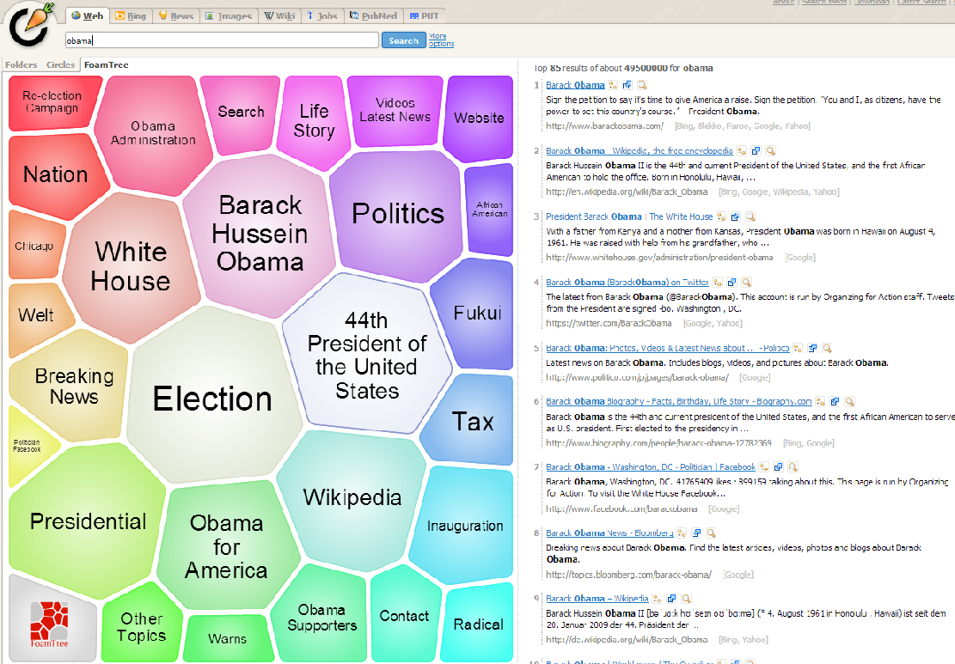
Carrot2’s foam tree display

Slide 17
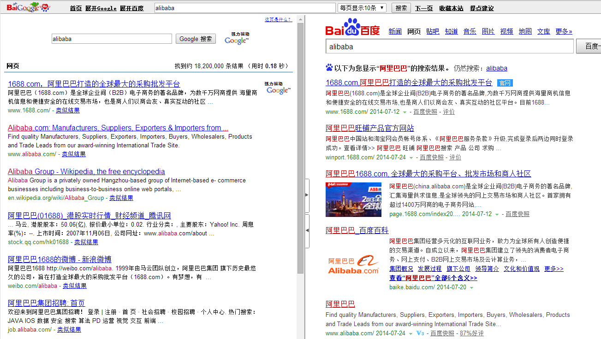
BaiGoogledu
Meta search engine

Slide 18
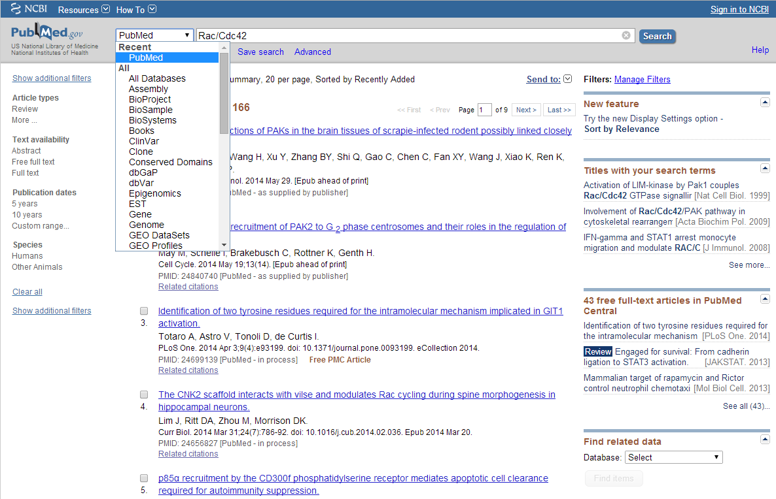
PubMed

Slide 19
Considerations in result display
Relevance
Order the results by relevance
Diversity
Maximize the topical coverage of the displayed results
Navigation
Help users easily explore the related search space
Query suggestion
Search by example

Slide 20
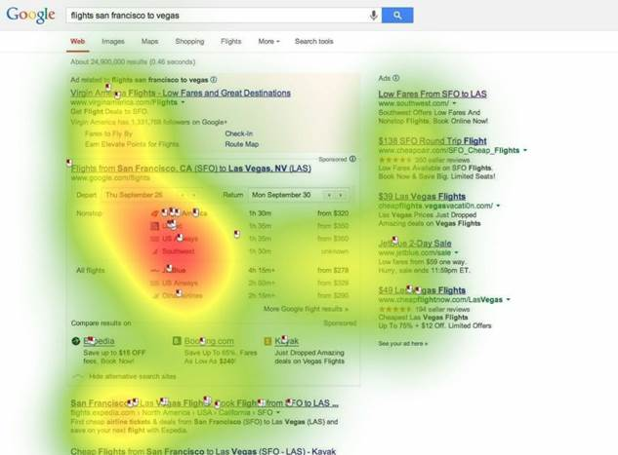
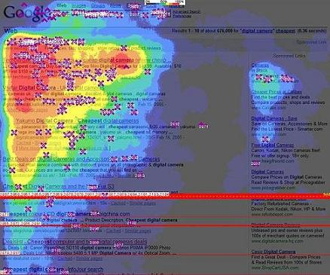
Research progress
In Human-Computer Interaction
Eye/Mouse tracking study of interaction between users and search result page
Psychological study of user behaviors
Facet categories, text summaries, colors, positions
In Information Retrieval
Less attention has been put in this aspect in history
Attracting more and more research focus now

Slide 21
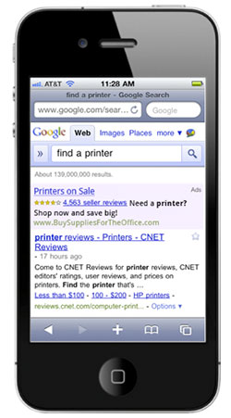
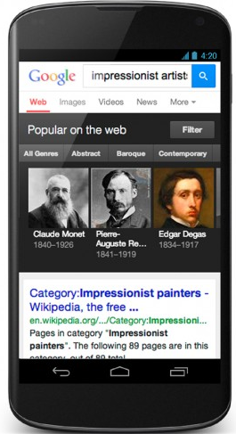
Search result display in mobile device
Unique characteristics of mobile device
Small screen size, limited bandwidth, input, data-access and computation power
Multi-touch screen
Rich search context
Opportunities?

Slide 22
What you should know
General considerations in search result display
Challenges and opportunities in mobile device search result display

